Slide 1
Fear, Uncertainty And AI: Why Is Operationalizing AI So Scary?
Richard Bird
Chief Security Officer
Singulr AI

Slide 2
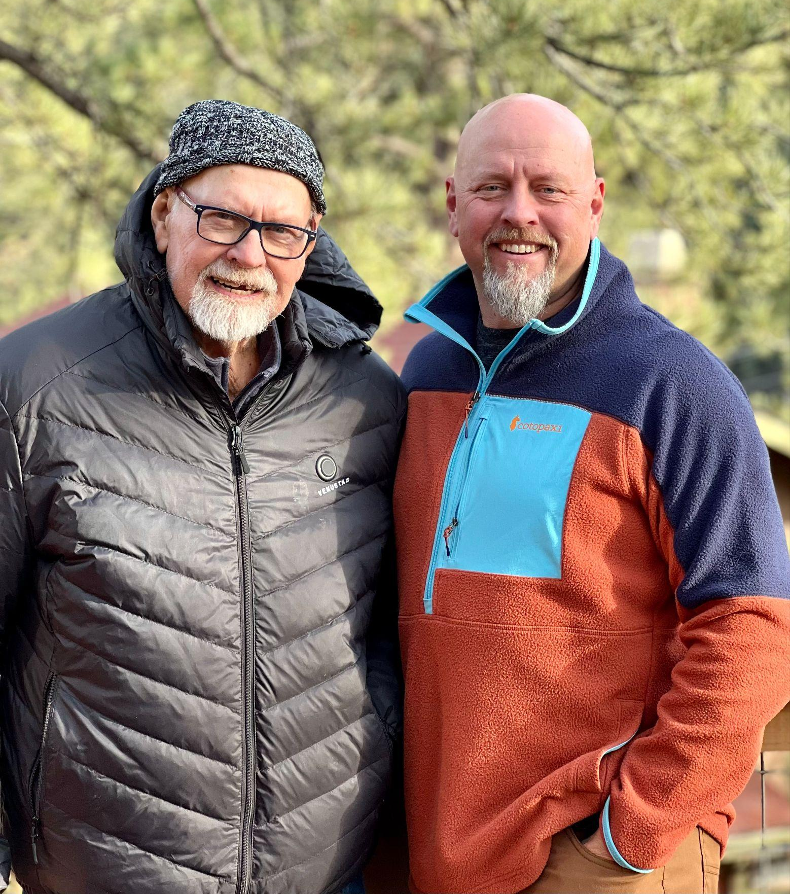
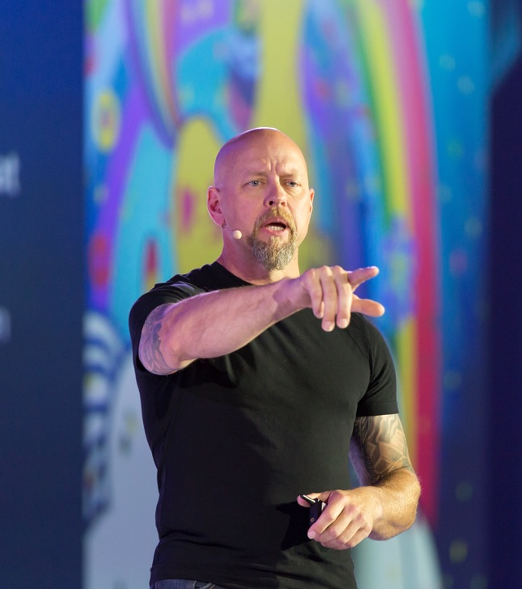
But First - Who Is This Guy?

Slide 3
AI Isn’t Only About LLMs or Model Poisoning Anymore
“I’ve been told to stand down - we need to maximize the value we can get from AI and we will worry about security later…”
Fortune 500 CISO
“We signed an enterprise agreement for 400 Grammarly licenses. We found out 800 people in the company were using Grammarly…”
Fortune 2000 CISO
“We’re seeing 10 to 30 new AI services, agents embedded AI features in our enterprise solutions every week and we haven’t barely scratched the surface in approving all the requests we’ve already received…”
Fortune 1000 Head of GRC

Slide 4
Your Employees Aren’t Waiting For Your Devs
While 47% of companies say they are developing their own AI - almost all of them are using open source AI repositories like Hugging Face… sooooo, not actually homegrown.
100% of companies are exposed to externally provided AI services, agents and embedded AI features in the enterprise solutions used across their organizations..
Externally provided AI services, agents and embedded AI features represent the vast majority of AI related compute being used by every company on the planet.
YOU DON’T CONTROL THEIR AI !

Slide 5

It’s Kinda Like…
Notes:
Third Party Risk Management or Supply Chain Security got together and had a baby with Freddy Krueger

Slide 6
But Why Are We Really Afraid?
Analysis paralysis
Unsanctioned AI use
Privacy violations
Malicious AI agents or services disguised as “cool things”
AI data consumption and retention that violates your data domicility or DPA requirements
Bad or non-existent controls by the AI companies “out there”
“Who, actually, is in charge of AI?”
Moving to fast
Failure to move fast enough
AI services or agents from embargoed nations
Sanctioned AI use but the approved AI changes
AI use with no contract, no security review and no recourse

Slide 7
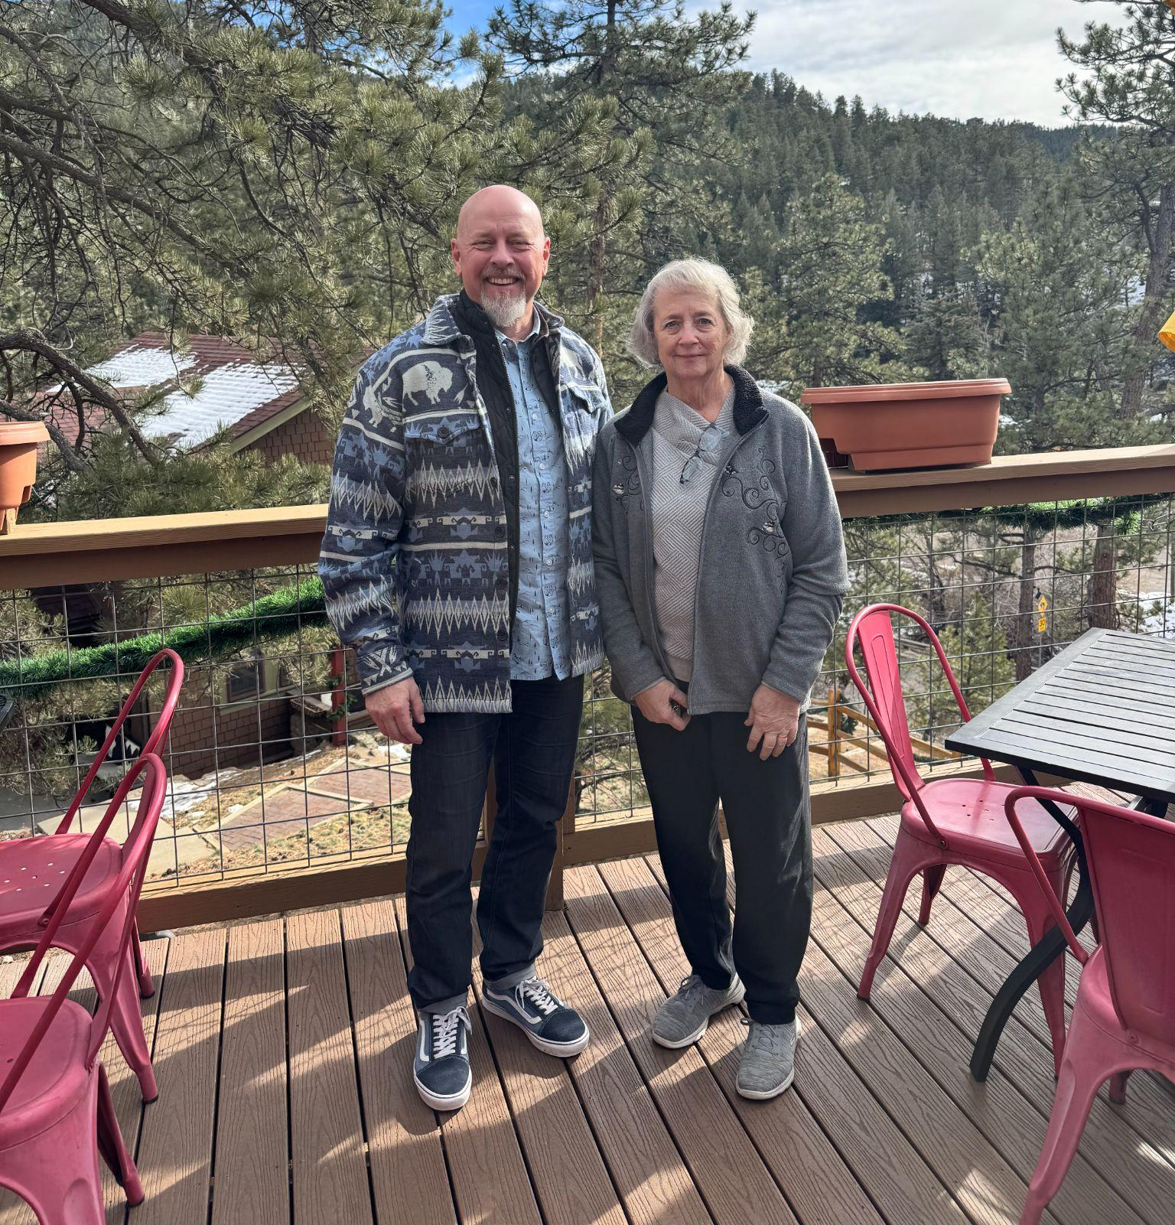
Annndddd…

Slide 8
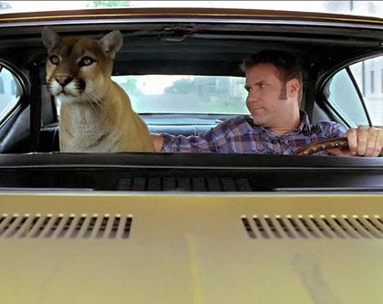
So What We Do?
Ain’t nothing more damn frightening than driving with a cougar in the car…
Notes:
Well - what we have to remember about AI is that the great philosopher, Ricky Bobby has shown us the way…

Slide 9
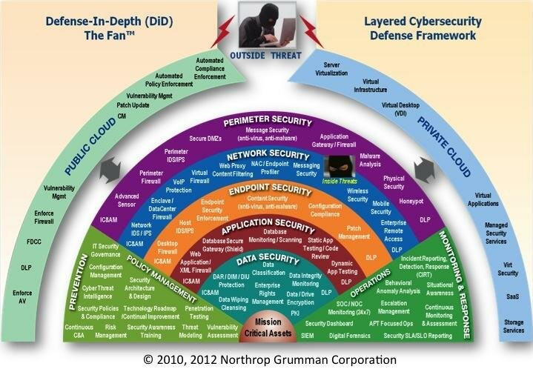
Let’s Address The AI Elephant In The Room
AI Control, Governance and Security Is Different

Slide 10
How Is It Different?
OSI, DID, ZT - Security architectures that protect static assets
AI agents, services and features are not static
AI agents, services and features are “vampires”
Once you invite them in - you can’t see what they’re doing
AI agents, services and features change, evolve, shift and learn

Slide 11
AI Usage and Consumption Is Bigger Than Security
Govern
Assess Strategic Alignment
Apply Controls
Discover
Evaluate Biz and Ops Risks
Optimize
Evaluate Cyber Risks
Secure
Authorize to Operate
Approve Use Cases
Continuous Monitoring
Company Risk Appetite
Company Policies
Legal Requirements
Security Frameworks
Audit Oversight
Compliance
Return on Investment
Resiliency
Business & Operations Risks
Cyber Risks

Slide 12
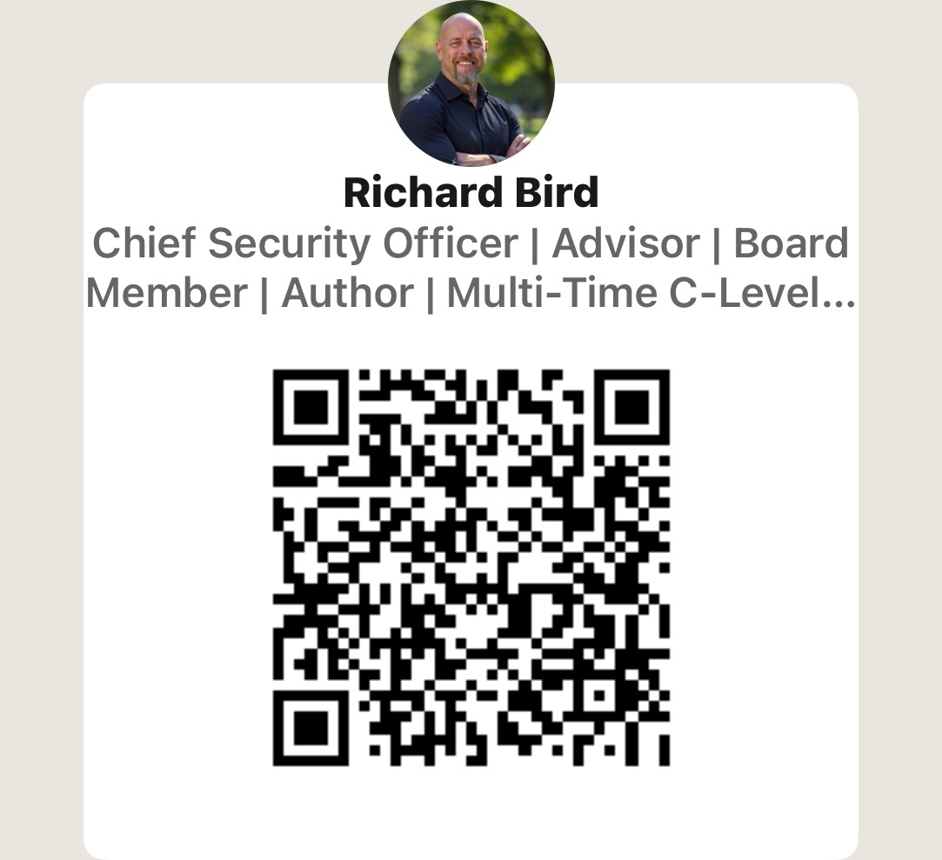

No More Fear - Let’s Get to Work

